Slide 1
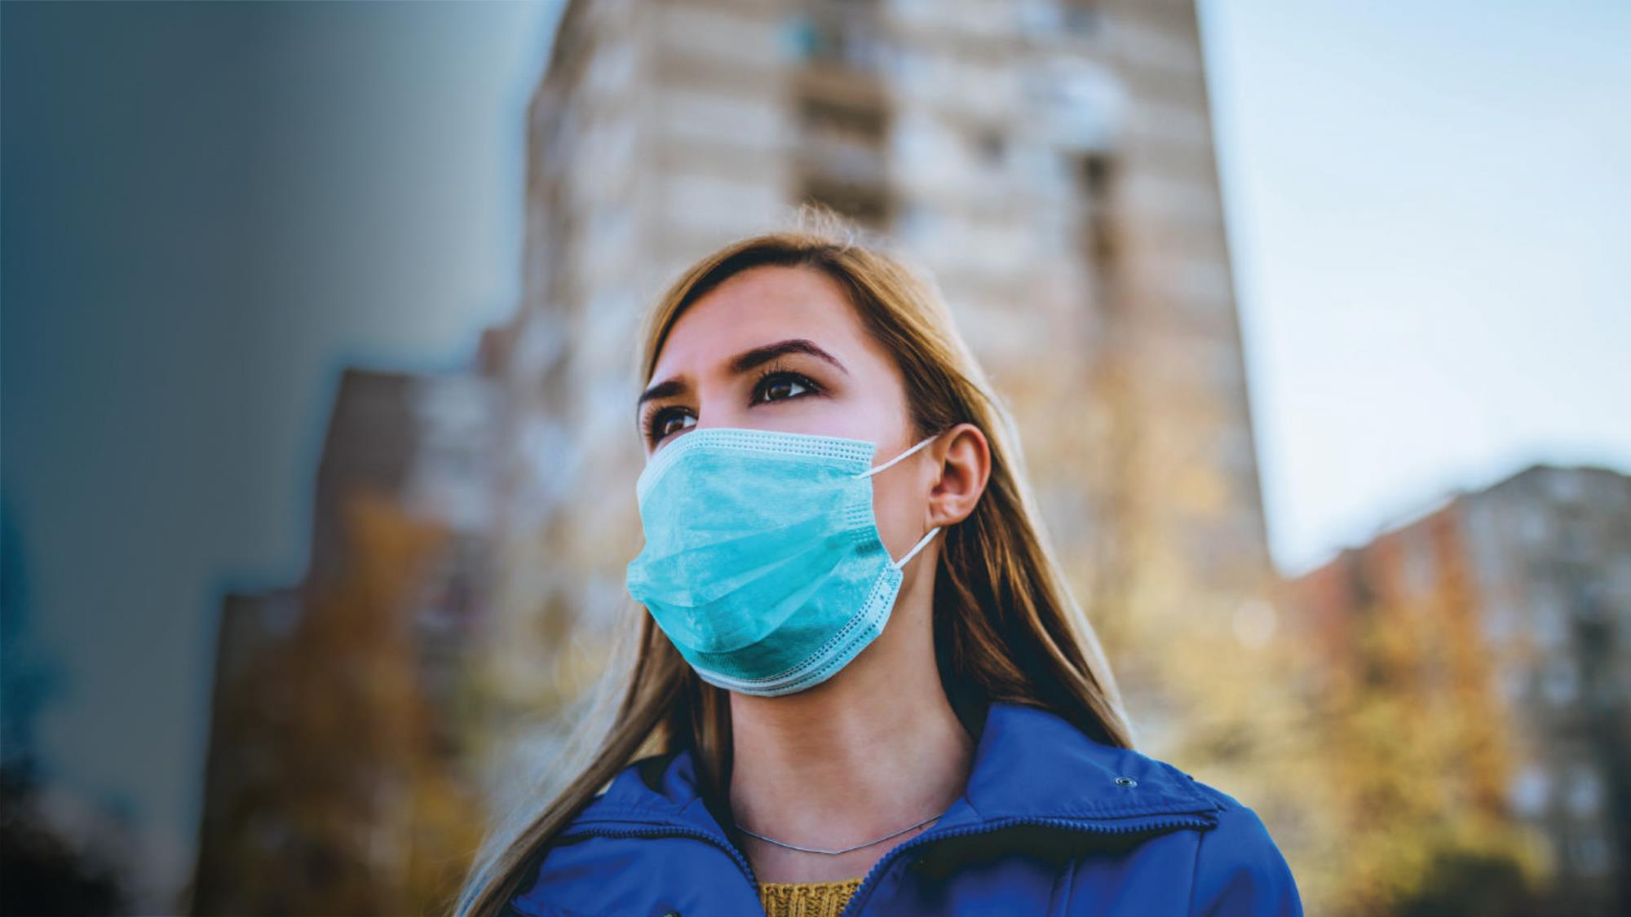
COVID-19
Barometer
Press Briefing
Rosie Hawkins, Karin van Wouwe, Jane Ostler
April 23, 2020

Slide 2
1
Setting the context

Slide 3
The largest study of its kind exploring the marketing implications of COVID-19
United States
Canada
Mexico
Guatemala
Belgium
Bulgaria
Croatia
Czech Republic
Denmark
Finland
France
Germany
Greece
Hungary
Italy
Netherlands
Norway
Poland
Portugal
Republic of Ireland
Romania
Serbia
Slovak Republic
Spain
Sweden
Switzerland
Turkey
United Kingdom
Ukraine
Egypt
Nigeria
Kenya
Mauritius
Reunion Island
South Africa
Argentina
Brazil
Chile
Colombia
Ecuador
Peru
China
India
Indonesia
Israel
Japan
Kazakhstan
Malaysia
Philippines
Russia
Saudi Arabia
Singapore
South Korea
Thailand
United Arab Emirates
Australia
Countries highlighted are shown in this report as we’re comparing wave 1-3 data

Slide 4
COVID-19 timeline
Mar. 14-19
Barometer wave 1 in field
Mar. 27-30
Barometer wave 2 in field
Feb. 11
The disease officially named COVID-19.
Mar. 13
Europe has become the epicentre of the pandemic
Mar. 18
DOW falls below 20,000 points for first time since 2017
Jan. 23
China locks
down Wuhan
Mar. 23
UK goes into lockdown
Mar. 25
The death toll in Spain surpassed that of mainland China
Mar. 30
A third of the global population is on lockdown
Mar. 9
Italy goes into lockdown.
Mar. 28
Cases of COVID-19 surpass 600,000
Mar. 14
Spain goes into lockdown
Mar. 20
Germany begins lockdown
Mar. 17
France goes into lockdown
Dec. 31
New type of pneumonia detected in Wuhan.
Jan. 30
Coronavirus declared Public Health Emergency of Int’l Concern
Mar. 11
US restricts travel from most of Europe
Mar. 23
2020 Olympics officially postponed
Mar. 25
In Italy, the number of new cases appears to be decreasing
Mar. 15
Cases in Africa are on the rise.
Feb. 28
Infections in Europe spike.
Mar. 26
Total confirmed cases in the US the highest in the world
Mar. 28
China begins to lift its lockdown

Slide 5
COVID-19 timeline continued
April 10-13
Barometer wave 3 in field
April 24-27
Barometer wave 4 in field
April 6
U.K. Prime Minister Boris Johnson is moved to intensive care after his COVID-19 symptoms worsen
April 13
China has imposed restrictions on the publication of research that focuses on the origins of COVID-19
April 2
Cases of COVID-19 surpass 1 million.
April 8
China lifts its lockdown on Wuhan
April 15
Cases of COVID-19 surpass 2 million.
April 17
WHO emphasizes that there is no evidence to prove immunity
April 1
The number of deaths from COVID-19 globally has more than doubled in the past week
April 3
The global economic impact of the COVID-19 pandemic is estimated to be between $2 trillion and $4 trillion
April 7
Cases of COVID-19 in Africa surpass 10,000 with over 500 deaths.
April 9
One hundred days have passed since WHO was initially notified of COVID-19 in China, which was then only known as cases of “pneumonia with unknown cause.”
April 14
Trump announces he is cutting off the nation’s contributions to the WHO
Notes:
Focus on the restrictions that have been lift in China right before FW and that it has been 100 days since the first case?

Slide 6
2
Overall feelings and concerns

Slide 7
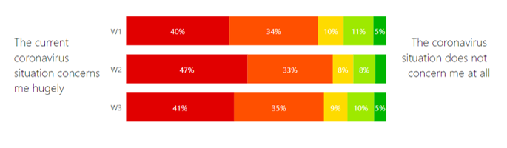
Levels of concern spiked during the “lockdown shock” at the end of March. As people adjust to their new normal, concern is still high but stable

Slide 8
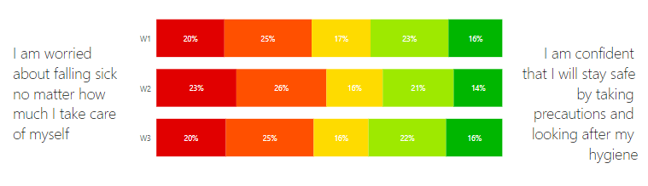
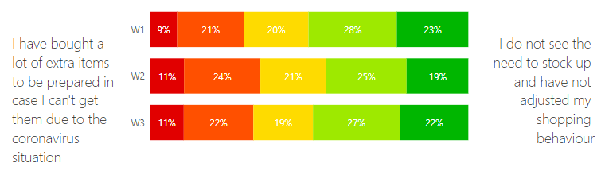
Specific concerns about personal health and scarcity have also dialled back as people adjust to their new normal
Concern around health
Concern around scarcity

Slide 9
Information needs have evolved – mixed messages and varied government responses are raising questions around use of face masks
How long does the virus live on surfaces?
How likely am I to catch the virus?
What are the symptoms?
Who is at risk of developing severe illness?
Should I wear a facemask?
Notes:
Most trusted sources of news are – and continue to be:
National news channels
Government agency websites
International advisory body websites

Slide 10
3
Financial concerns

Slide 11
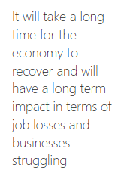
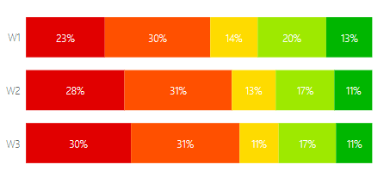
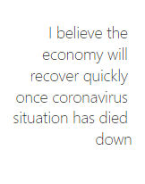
Concerns for the economy continue to grow
Notes:
First of all, the concerns for the economy continue to grow. Driven by what has been communicated in the media, most people feel that it will take a long time for the economy to recover and this will have a long term impact.

Slide 12


COVID-19 has impacted or will impact household income for…
71%
…of households
Notes:
We also see that the current crisis and lockdown situations all over the world have impact or will impact 71% of households worldwide.

Slide 13
25-34s are most affected - feeling the immediate impact on household income
Impact on household income
71%
By age
75%
81%
75%
56%
Notes:
Both the 18-24s and 24-35s felt the impact more immediately - are more likely to work in industries and in positions more susceptible to being laid off due to COVID-19, such as entry level roles or gig economy jobs.
And the burden felt acutely by the 24-34s
For both age groups – particularly the 24-34s – this concern is translating into behaviour. They are being more proactive about their financial planning and both are paying more attention to prices and buying products on sale.
And buying a more products. When we looked at concerns over scarcity earlier, we saw 36% of people saying they’d bought extra items in case things aren’t’ available. That figure is 42% among the 18-24s and 25-34s.
And the 18-24s are buying more long life products to plan.

Slide 14
4
The GenZ and Millennial
experience
Notes:
So let’s dive into the world of GenZ and Millennials more. There’s a few different definitions being used for these generations, so let’s make sure we all know what were talking about. GenZ is mostly defined as people who are born after 1996, meaning they’re 24 or younger now. When we talk about GenZ today it’s the age group of 18-24 year olds. Also known as the generation who has never known a world without the internet in their pocket. We interviewed over 3,500 of these “Zoomers” in our latest Barometer wave.
When talking about millennials, it’s the current generation of “grown ups”, at least that’s how GenZ looks at it. Our definition of millennials here is people born from 1986-1995, so the 25-34 years olds now, of whom we interviewed over 6,000.
GenZ = 18-24s
Millennials = 25-34s

Slide 15
Level of concern isn’t greater, but their experience is different
Overall level of concern
Impact on day to day life
GenZ
Millennials
GenZ
Millennials
Notes:
Compared to the older age groups, both GenZ and Millenials are less concerned about the situation overall. Most likely one of the reasons being they’re less likely to be caught heavily by the virus themselves. However, the impact on their day-to-day life is big. Imagine teenagers or early twentysomethings being stuck at home without going to college, side jobs or entry level roles. How bored would you be?
And also imagine being a millenial, being stuck in a tiny apartment, working from your kitchen table, not able to see your friends or your parents because they’re the group at risk. Or even more challenging, needing to combine having a baby or small kids who cannot go to daycare or primary school with a full time job.

Slide 16
7
Summary and call to action

Slide 17
GenZ and Millennials
The GenZ and Millennial experience
Media and advertising opportunities
The role for brands
Harder hit in financial terms – feeling the immediate impact and more worried for the future
They both feel the impact on their day-to-day lives and miss social interaction. But their coping strategies suggest different motivations. GenZ is focused on alleviating boredom. Millennials experience a higher level of anxiety and focus more on stress management
As we see the usage of popular communication and social apps increase, there are more
opportunities to communicate brand values on these platforms. And people are open to (seeing relevant) advertising.
Content needs to be tailored to the platform context. And spikes in social media platform usage create opportunities to adapt your media strategy to maximise efficiencies (increasing impact with no additional cost
There’s a role for brands to play, but it needs to be practical, substantial and positive.
GenZ expect brands to step and contribute to the worldwide efforts to overcome this crisis. Millennials are more focused on what brands can do to help consumers in practical ways

