Slide 1
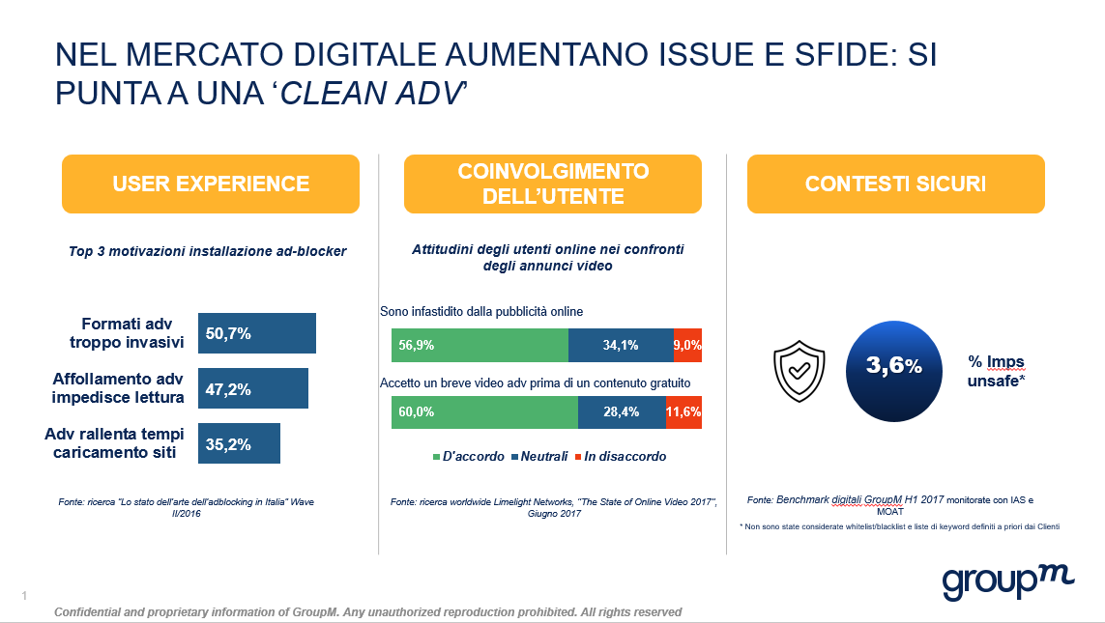

Slide 2
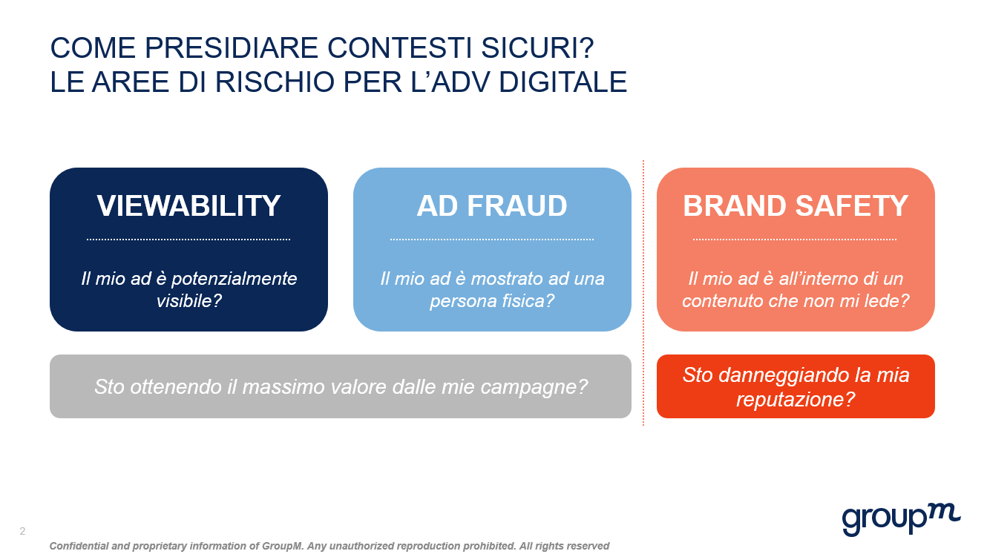

Slide 3
What is quality?
An ad that is seen, by a human, in the specified demographic and in a safe environment
Notes:
A quality "brand safe" impression might be described as one that is seen, by a human, who is in the defined target audience and in a safe environment. Thus, viewable, not fraudulent, in demo and with a low risk of appearing adjacent to inappropriate content.
It also means that we should address quality and measure media value in a different way - and by doing so, we may even end up paying less.

