Slide 1


COVID-19: Monitor Consumer Evolution and Brand Implications
Media Pack – wave 2
Gabriella Bergaglio
Marketing Director, Italy

Slide 2
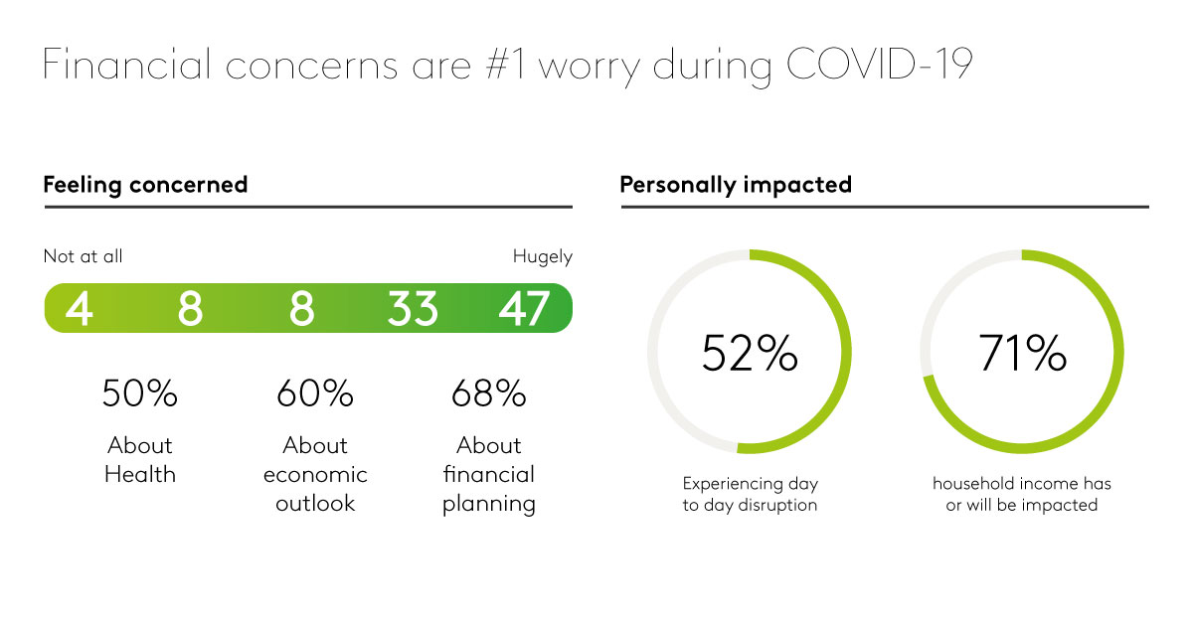
Contents
1 | Section divider | 3

Slide 3
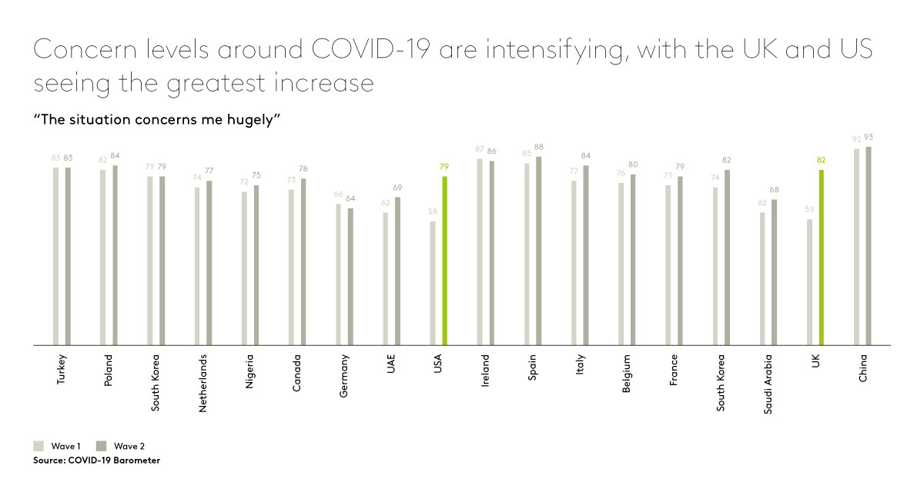

Slide 4
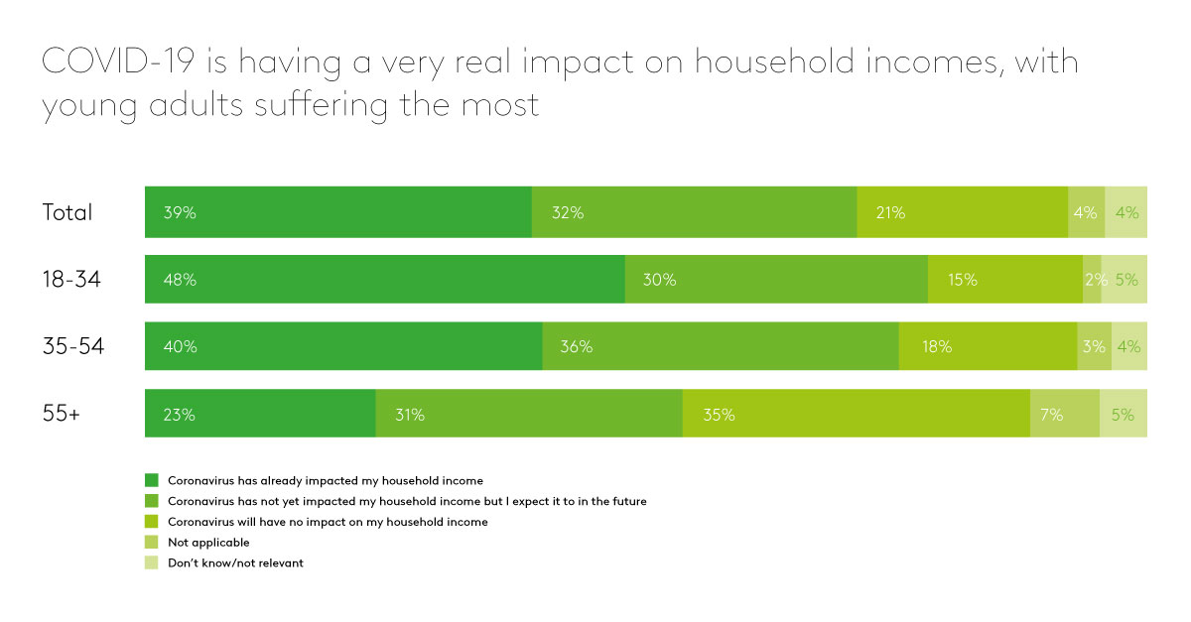

Slide 5
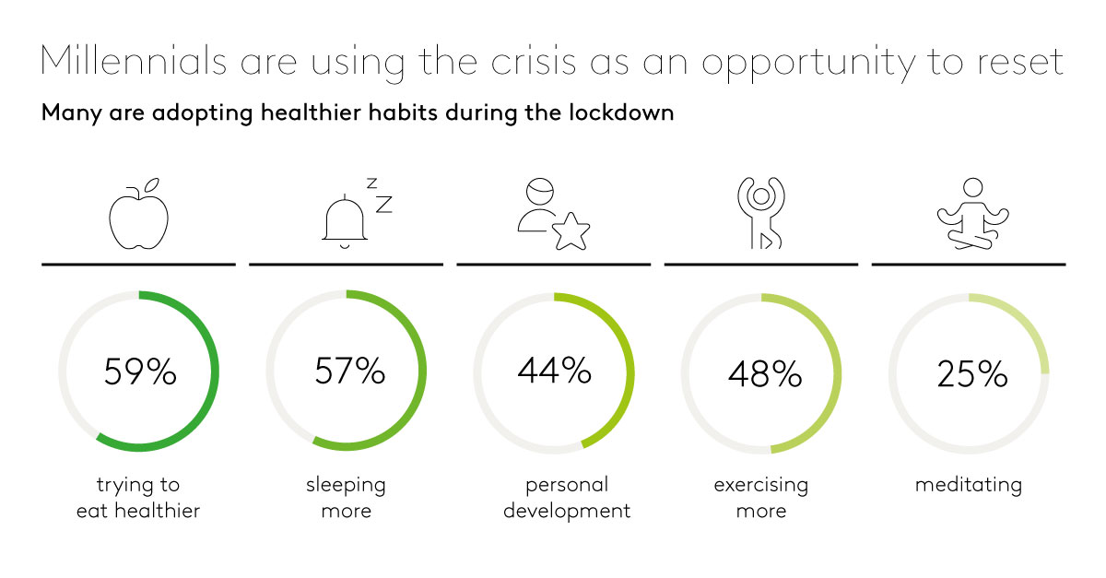

Slide 6
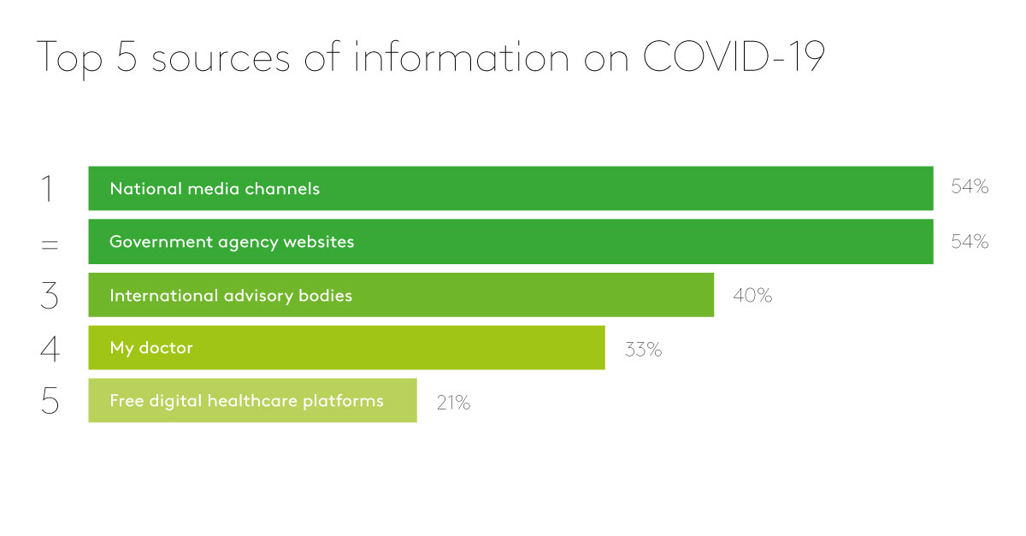

Slide 7
