Slide 1









The Global DEI
Census 2023
ITALY MARKET REPORT
SEPTEMBER 2023

Slide 2
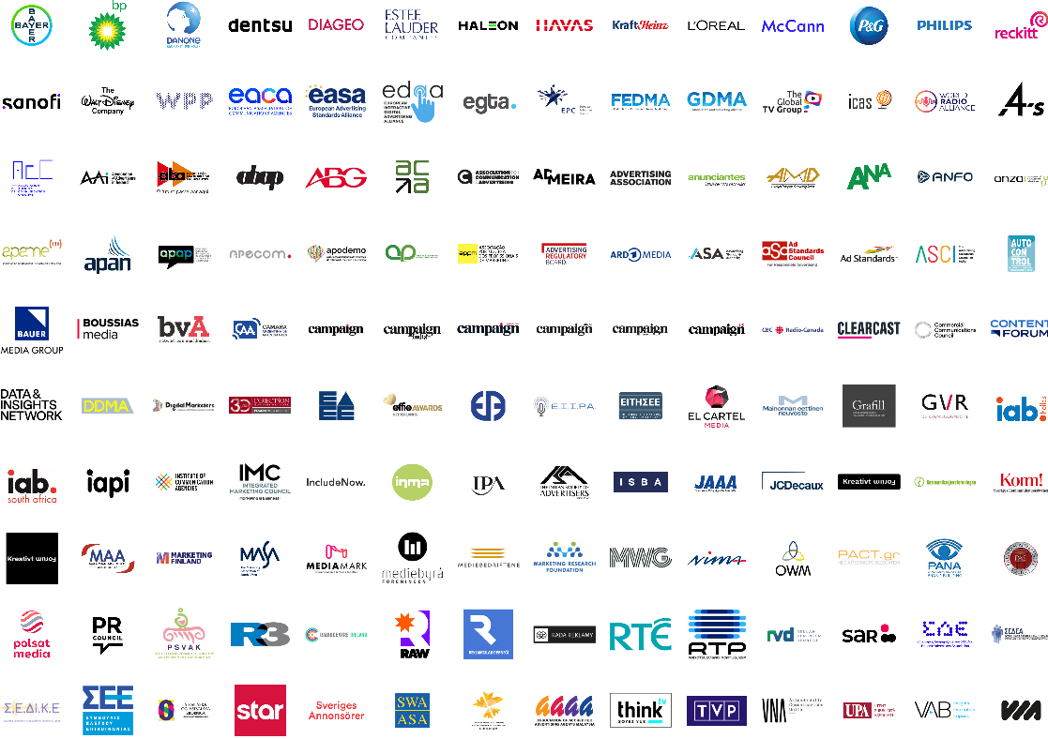

ACKNOWLEDGEMENTS
In total, WFA counted on the support
of more than 160 associations operating at global, regional and local level. That makes this effort the single biggest collaboration in the history of the global marketing industry.
The output is in-depth insight into the lived experiences of nearly
13,000 people across our industry, insights that will enable us to drive change.
To all those who partnered with us and to all those who responded to the survey, we are incredibly humbled
and grateful.
Notes:
Change image, AECA logo is the old one

Slide 3

METHODOLOGY
1
INCLUSION INDEX
DISCRIMINATION IN THE WORKPLACE
2
  Age
  Gender
  Family status
  Mental Health
HEADLINES

Slide 4








METHODOLOGY
2023 survey
Online survey commissioned to Kantar and conducted in March-April 2023
91
Across 91 countries
A broader reach of markets in 2023, making this a truly global census
Covering representation and people’s experiences at their companies
~13k
33
In-depth analysis into 33 very different markets
Argentina, Brazil, Canada, Finland, Germany, Greece, Hong Kong, SAR, Italy, Ireland, India, Japan, Malaysia, New Zealand, Netherlands, Norway, Pakistan, Philippines, Poland, Portugal, Singapore, Slovenia, South Africa, Spain, Sweden, Switzerland, Turkey, the Gulf Cooperation Council (Bahrain, Kuwait, Oman, Qatar, Saudi Arabia, UAE), and the USA
Gender
Age
Race & ethnicity
Sexuality
Nearly 13,000 respondents giving us detailed insight into people’s lived experiences from across our industry globally
Disability
Sense of belonging Experience of negative behaviours Discrimination
Mental health
Notes:
This is not a census in the strict sense of the word. Given the sensitivity of asking questions about people’s identity, such a survey must be anonymous and voluntary

Slide 5
1.
THE DEI GLOBAL INCLUSION INDEX

Slide 6


ABOUT THE INCLUSION INDEX
The Inclusion Index is comprised of three sub-indices created through factor analyses, based on an employee’s perception of the environment and their experience at the company.
SENSE OF BELONGING
ABSENCE OF DISCRIMINATION
PRESENCE OF DEMEANING BEHAVIOR
While there are many diversity dimensions to consider, the Inclusion Index is based on these five: gender, ethnicity, sexual orientation, religion and disability*.
THE INCLUSION INDEX SCORE
IS THE FOLLOWING FORMULA:
*Note this will vary by market depending on questions asked
COMPANY SENSE OF BELONGING
ABSENCE OF
DISCRIMINATION
Presence
of negative behaviour
*Disability is not reported due to the limited number of respondents; Race & Ethnicity is not observed in Italy

Slide 7
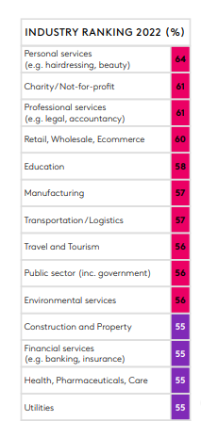
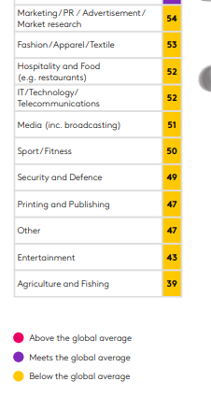
By using benchmark data, we can provide an unbiased perspective on what good looks like and enable development of an actionable roadmap
In 2022 alone, we have used the data collected to build a vast normative data set that covers over 24 industries. Over 12,000 respondents across 13 countries.
These norms will evolve alongside society and as more survey responses are added to the data set
Kantar has proprietary data collected in 13 markets while having done inclusion work in many more market

Slide 8

ITALY SCORES BELOW THE GLOBAL
INCLUSION INDEX BENCHMARK
59%

Slide 9
IT IS RECOGNISED THAT PROGRESS HAS BEEN MADE, BOTH AT INDUSTRY AND COMPANY LEVEL, BUT THERE’S ALSO WIDESPREAD CONVICTION THAT THERE’S STILL LOTS TO DO
In terms of the industry becoming more diverse and inclusive in the last 2 years
Respondents agreeing that their company is actively taking steps to be more diverse and inclusive
But there’s the widespread opinion their company should do more
Things have improved
Things are about the same
v
Global average
Italy 2023 survey
v

Slide 10
DEI CENSUS INCLUSION INDEX SCORE 2023
59%
64%
SENSE OF BELONGING
69%
Global benchmark
98%
ABSENCE OF DISCRIMINATION
96%
Global benchmark
21%
PRESENCE
OF NEGATIVE BEHAVIOUR
19%
Global benchmark

Slide 11
SENSE OF BELONGING AT YOUR COMPANY
ITALIANS REPORT TO BE LESS SUPPORTED AND MORE DISCRIMINATED
 |  | Italy vs Global
Company Sense of Belonging Percent | 64% | -5%
I am a valued and essential part of my company - % agree | 60% | -11%
I am provided with sufficient support to develop my skills and progress my career - % agree | 48% | -9%
Senior management do not discriminate when it comes to hiring or career advancements of those that report into them - % agree | 48% | -7%

Slide 12
SENSE OF BELONGING AT YOUR COMPANY- ITALIANS REPORT TO BE LESS SUPPORTED AND MORE DISCRIMINATED
 | GLOBAL TOTAL | GLOBAL MEN | GLOBAL WOMEN | ITA TOTAL | ITA VS GLOBAL | ITA MEN | ITA WOMEN | ITA W vs M
Inclusion Index | 63% |  |  | 59% | -4%
Company Sense of Belonging Percent | 69% | 72% | 67% | 64% | -5% | 67% | 61% | -6%
I feel like I belong at my company - % agree | 74% | 77% | 72% | 71% | -3% | 74% | 69% | -5%
I am a valued and essential part of my direct team - % agree | 82% | 85% | 81% | 81% | -1% | 84% | 80% | -4%
I am a valued and essential part of my company - % agree | 71% | 75% | 69% | 60% | -11% | 66% | 57% | -9%
I am emotionally and socially supported at work - % agree | 64% | 66% | 63% | 57% | -7% | 57% | 57% | 0%
My unique attributes, characteristics, skills, experience and background are valued in my company - % agree | 70% | 75% | 68% | 69% | -1% | 80% | 63% | -17%
Most employees in my company feel comfortable being themselves - % agree | 75% | 78% | 74% | 74% | -1% | 79% | 71% | -8%
Senior management do not discriminate when it comes to hiring or career advancements of those that report into them - % agree | 55% | 61% | 52% | 48% | -7% | 58% | 42% | -16%
I am provided with sufficient support to develop my skills and progress my career - % agree | 57% | 60% | 56% | 48% | -9% | 53% | 45% | -8%

Slide 13
PRESENCE OF NEGATIVE BEHAVIOUR – MORE ALIGNED WITH GLOBAL BENCHMARKING. IT ASSUMES THE FORM OF DEMEANING AND EXCLUSION
 |  | Italy vs Global
Presence of Negative Behavior | 21% | +2%
Unfairly spoken over and not listened to in meetings - % yes | 35% | +9%
Undervalued compared to colleagues of equal competence - % yes | 34% | +5%
Exclusion from events/activities - % yes | 19% | +5%

Slide 14
PRESENCE OF NEGATIVE BEHAVIOUR – MORE ALIGNED WITH GLOBAL BENCHMARKING. IT ASSUMES THE FORM OF DEMEANING AND EXCLUSION
 | GLOBAL TOTAL | GLOBAL MEN | GLOBAL WOMEN | ITA TOTAL | ITA VS GLOBAL | ITA MEN | ITA WOMEN | ITA W vs M
Presence of Negative Behavior | 19% | 16% | 21% | 21% | 2% | 17% | 24% | 7%
Unfairly spoken over and not listened to in meetings - % yes | 27% | 21% | 30% | 35% | 9% | 32% | 38% | 6%
Learning Opportunities or progress restricted by senior colleagues - % yes | 17% | 15% | 18% | 14% | -3% | 14% | 14% | 0%
Undervalued compared to colleagues of equal competence - % yes | 28% | 23% | 31% | 34% | 5% | 21% | 40% | 19%
People taking sole credit for shared efforts - % yes | 32% | 29% | 33% | 35% | 3% | 35% | 35% | 0%
Bullied, undermined or harassed in any way - % yes | 13% | 10% | 15% | 9% | -5% | 5% | 11% | 6%
Physical harassment or violence - % yes | 1% | 1% | 1% | 1% | 0% | 2% | 1% | -1%
Exclusion from events/activities - % yes | 13% | 12% | 14% | 19% | 5% | 14% | 22% | 8%
Made to feel uncomfortable in the workplace - % yes | 22% | 18% | 24% | 23% | 1% | 15% | 27% | 12%

Slide 15
2.
DISCRIMINATION IN THE WORKPLACE

Slide 16
THE MOST COMMON FORMS OF DISCRIMINATION REPORTED
ARE STILL AROUND GENDER, AGE AND FAMILY STATUS
Gender
Age
Family responsibilities*
Experience personally or observed discrimination
due to gender
WOMEN 21%|
MEN 8%
Experience personally or observed discrimination
due to their age
WOMEN 15%| MEN 10%
Experience personally or observed discrimination
due to their family responsibilities
WOMEN 18%| MEN 9%
16%
13%
14%
44% of women
50% of 45-54 yo
54% of parents
believe that gender can hinder one’s career at their company vs 13% of men
believe that age can hinder one’s career at their company vs 39% of total respondents
believe that family responsibilities can hinder one’s career at their company vs 43% of total respondents
Disability is not reported due to the limited number of respondents; Race & Ethnicity is not observed in Italy
Family responsibilities includes if respondents have children responsibilities or other caregiver responsibilities,
i.e. they look after or give help or support to anyone because they have a long-term physical or mental health condition or illness, or problems related to old age, etc.

Slide 17

1
Sense of belonging at their company is lower among women than men.
The gender gap in Italy is higher than the global one
17
GENDER IN ITALY: KEY TAKE OUTS
2
Women report that discrimination exists:
gender hinders women careers
trust in the escalation process to senior manager is limited
claimed pay gap persists
3
Women report being harassed:
discomfort is most often reported
escalation is rarely acted upon
women fear the escalation process might generate retaliation

Slide 18

18
GENDER IN ITALY - SENSE OF BELONGING
THERE’S A GAP BETWEEN MEN AND WOMEN
ITALY
64 %
WOMEN
61%
GLOBAL
69 %
MEN
67%
64% of ITALIAN respondents sense they belong at their company, compared
to 69% of Global benchmark.
61% of ITALIAN women sense they belong at their company, compared to 67% of men.

Slide 19

SENSE OF BELONGING AT YOUR COMPANY
WOMEN REPORT TO BE LESS VALUED AND MORE DISCRIMINATED
 |  | Italy vs Global | women vs men | women vs men
Company Sense of Belonging Percent | 64% | -5% | -6% | -5%
My unique attributes, characteristics, skills, experience and background are valued in my company - % agree | 69% | -1% | -17% | -7%
I am a valued and essential part of my company - % agree | 60% | -11% | -9% | -6%
I am provided with sufficient support to develop my skills and progress my career - % agree | 48% | -9% | -8% | -4%
Senior management do not discriminate when it comes to hiring or career advancements of those that report into them - % agree | 48% | -7% | -16% | -9%

Slide 20
SENSE OF BELONGING AT YOUR COMPANY- ITALIANS REPORT TO BE LESS SUPPORTED AND MORE DISCRIMINATED
 | GLOBAL TOTAL | GLOBAL MEN | GLOBAL WOMEN | ITA TOTAL | ITA VS GLOBAL | ITA MEN | ITA WOMEN | ITA W vs M
Inclusion Index | 63% |  |  | 59% | -4%
Company Sense of Belonging Percent | 69% | 72% | 67% | 64% | -5% | 67% | 61% | -6%
I feel like I belong at my company - % agree | 74% | 77% | 72% | 71% | -3% | 74% | 69% | -5%
I am a valued and essential part of my direct team - % agree | 82% | 85% | 81% | 81% | -1% | 84% | 80% | -4%
I am a valued and essential part of my company - % agree | 71% | 75% | 69% | 60% | -11% | 66% | 57% | -9%
I am emotionally and socially supported at work - % agree | 64% | 66% | 63% | 57% | -7% | 57% | 57% | 0%
My unique attributes, characteristics, skills, experience and background are valued in my company - % agree | 70% | 75% | 68% | 69% | -1% | 80% | 63% | -17%
Most employees in my company feel comfortable being themselves - % agree | 75% | 78% | 74% | 74% | -1% | 79% | 71% | -8%
Senior management do not discriminate when it comes to hiring or career advancements of those that report into them - % agree | 55% | 61% | 52% | 48% | -7% | 58% | 42% | -16%
I am provided with sufficient support to develop my skills and progress my career - % agree | 57% | 60% | 56% | 48% | -9% | 53% | 45% | -8%

Slide 21


21
WOMEN REPORT GENDER DISCRIMINATION: IT IS EXPERIENCED, IT CAN HINDER THE CAREER, IT IS CONFIRMED BY SALARY GAP.
AND WOMEN’S TRUST IN THE EFFECTIVENESS OF THE ESCALATION PROCESS IS LIMITED.
AVERAGE PAY BY GENDER
Level | % Gap average salary
Exec management/c-suite | -7%
Other senior staff | -5%
Manager | 0%
Junior | -2%
8% of women have experienced discrimination personally at their company based on their gender vs 1% of men. |  | 15% of women have observed discrimination based on gender towards other at their company vs 7% of men.
42% of women believe that most colleagues would escalate inappropriate behaviour to senior management or HR, compared to 54% of men. |  | 44% of believe that gender can hinder one’s career at their company vs 13% of men
Note: these are indicative pay gaps only based on salary bands selected and not on actual salary data
My company provides equal pay for equal work
(% agree)

Slide 22




HARASSMENT IS MAINLY REPORTED IN TERMS OF SENSE OF DISTRESS. ESCALATION PROCESS IS SELDOM ACTED UPON, BOTH WHEN THE NEGATIVE BEHAVIOUR IS EXPERIENCED AND OBSERVED
Have you experienced in the last 12 months any of the following?
Did you feel confortable in raising it to senior leaders or HR?
Base: those who experienced / Have observed (*)
33%
Yes, and I did raise it
25%
WHY NOT?
I do not trust the process of escalation
It could have a negative impact on
my career
The person responsible was my manager /
a senior leader
I do not think it was my place to do it
Verbal harrassment
8%
34%
No
Bullied or undermined
5%
33%
Yes, and I choose
not to raise it
30%
Made to feel unconfortable in the workplace
15%
45% No
Have you observed negative behaviour or discrimination towards others based on gender?
15%
Yes
24%
Yes, and I did raise it
45%
No
22%
31%
Yes, and I choose
not to raise it
36%
7% Yes
42% No
* caution: low base

Slide 23
PRESENCE OF NEGATIVE BEHAVIOUR - WOMEN REPORT TO BE LESS SUPPORTED AND MORE DISCRIMINATED THAN MEN
 |  | Italy vs Global | women vs men | women vs men
Presence of Negative Behavior | 21% | +2% | +7% | +4%
Undervalued compared to colleagues of equal competence - % yes | 34% | +5% | +19% | +8%
Made to feel uncomfortable in the workplace - % yes | 23% | +1% | +12% | +6%
Exclusion from events/activities - % yes | 19% | +5% | +8% | +2%

Slide 24
PRESENCE OF NEGATIVE BEHAVIOUR – MORE ALIGNED WITH GLOBAL BENCHMARKING. IT ASSUMES THE FORM OF DEMEANING AND EXCLUSION
 | GLOBAL TOTAL | GLOBAL MEN | GLOBAL WOMEN | ITA TOTAL | ITA VS GLOBAL | ITA MEN | ITA WOMEN | ITA W vs M
Presence of Negative Behavior | 19% | 16% | 21% | 21% | 2% | 17% | 24% | 7%
Unfairly spoken over and not listened to in meetings - % yes | 27% | 21% | 30% | 35% | 9% | 32% | 38% | 6%
Learning Opportunities or progress restricted by senior colleagues - % yes | 17% | 15% | 18% | 14% | -3% | 14% | 14% | 0%
Undervalued compared to colleagues of equal competence - % yes | 28% | 23% | 31% | 34% | 5% | 21% | 40% | 19%
People taking sole credit for shared efforts - % yes | 32% | 29% | 33% | 35% | 3% | 35% | 35% | 0%
Bullied, undermined or harassed in any way - % yes | 13% | 10% | 15% | 9% | -5% | 5% | 11% | 6%
Physical harassment or violence - % yes | 1% | 1% | 1% | 1% | 0% | 2% | 1% | -1%
Exclusion from events/activities - % yes | 13% | 12% | 14% | 19% | 5% | 14% | 22% | 8%
Made to feel uncomfortable in the workplace - % yes | 22% | 18% | 24% | 23% | 1% | 15% | 27% | 12%

Slide 25

PERCEPTIONS OF AGEISM IN ITALY IS ALIGNED WITH THE GLOBAL BENCHMARK, THOUGH ITS IMPACT ON CAREER IS HIGHER
ITALY
6%
WOMEN
8%
GLOBAL
8%
MEN
2%
Of respondents have personally experienced discrimination due to their age.
8% of Italian women have personally experienced discrimination due to their age, compared to 2% of men.
ITALY
39%
AGE
GLOBAL
32%
Of respondents believe that age can hinder one’s career at their company.

Slide 26




FAMILY RESPONSIBILITIES IMPACT CAREERS (IN ITALY MORE THAN ABROAD)
51% Women
54% Parents
50% Caregivers
51% of Italian women believe that family responsibilities can hinder one’s career at their company. They are 41% at global level. |  | Of Italian parents with dependent children believe that family responsibilities can hinder one’s career. They are 42% at global level. |  | Of Italian caregivers believe that family responsibilities can hinder one’s career at their company. They are 39% at global level.

Slide 27




MENTAL HEALTH IS A FORM OF DISTRESS WHICH IS NOT MANAGED BY COMPANIES. IT IMPACTS PHYSICAL HEALTH
I am often very stressed at work - % agree
My company has an active policy to minimise the risk of mental health issues.- % agree
My workplace is open about mental health –
% agree
My work is having
a negative impact on
my physical health –
% agree
42%
35%
50%
27%
52% IT
22% IT
31% IT
31% IT
26% NLD
52% SGP
67% PHL
18% BRA

Slide 28
HEADLINES

Slide 29
DEI INCLUSION INDEX HEADLINES
Italy scores below the global Inclusion Index benchmark
(59% vs 63%).
There is wide recognition from respondents that progress is being made, with 72% agreeing that their company is actively taking steps to be more diverse and inclusive.
43% of respondents agree things have improved in terms of the industry becoming more diverse and inclusive in the last 2 years, But the conviction there’s still lots to do is widespread.
HEADLINES
In an industry that is not very inclusive, Italy emerges as an even less inclusive country.
The drivers of this phenomenon are the modest sense of belonging and the presence of discriminatory behaviors – the situation more critical for women.
The areas in which discrimination manifests itself with greater intensity are gender, age and family status.
There is a non-trivial alert on mental health that is particularly relevant and unmanaged by companies.

Slide 30
4.
APPENDIX

Slide 31
INDEX QUESTIONS
COMPANY SENSE OF BELONGING
How strongly do you agree or disagree with these statements?
1. Strongly disagree
2. Disagree
3. Neither agree or disagree
4. Agree
5. Strongly agree
99. Prefer not to answer
I feel like I belong at my company.
I am a valued and essential part of my direct team.
I am a valued and essential part of my company.
I am emotionally and socially supported at work.
My unique attributes, characteristics, skills, experience and background are valued in my company.
Employees in my company feel comfortable being themselves.
Senior managers are fair when it comes to hiring or career advancements of those that report into them.
I am provided with sufficient support to develop my skills and progress my career.
PRESENCE OF NEGATIVE BEHAVIOUR
Have you experienced any of the following within the last 12 months at your company? Yes/No
Unfairly spoken over or not listened to in meetings.
Learning opportunities or progress restricted by senior colleagues.
Undervalued compared to colleagues of equal competence.
People taking sole credit for shared efforts.
Bullied or undermined in any way.
Physical harassment or violence.
Exclusion from events or activities.
Made to feel uncomfortable in the workplace.
ABSENCE OF DISCRIMINATION
At your company, have you personally experienced negative discrimination in the following area? Yes/No
Age
Gender
Family responsibilities
Race
Religion
Disability status
Sexual orientation
Appearance
Social background

